Slide 1
Aerial Swarm Simulators
Presented By: Naimah Chapman, Elijah Keck, Dillon Mead, and John Mueller

Slide 2
Introduction
This system simulates an unmanned aerial swarm. The aerial swarm will be autonomous with unified, cohesive behavior. The general mission for the aerial swarm will be to collect data from a three-dimensional environment (e.g. the volume of a plume of smoke).
Benefits:
Safer for personnel studying or monitoring volcanoes, wildfires, etc.
Easier to fly multiple UAV in precarious, time - constrained situations.

Slide 3
Design Considerations
Assumptions: TBD
Dependencies
Only usable within Microsoft’s Airsim
Unreal Engine 4 and Visual Studio 2019
Design Constraints
Does not use realistic radio communication
Collisions/ objects constrained by Unreal Engine
No safety or cyber security considerations as a simulation.

Slide 4
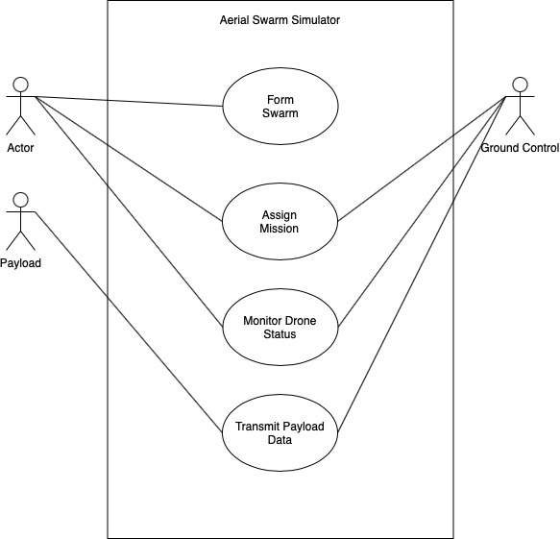
System Architecture (High to Low)

Slide 5
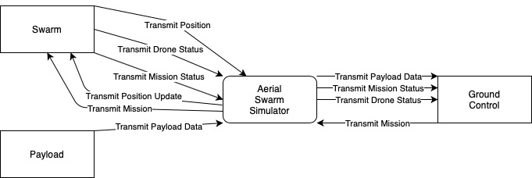
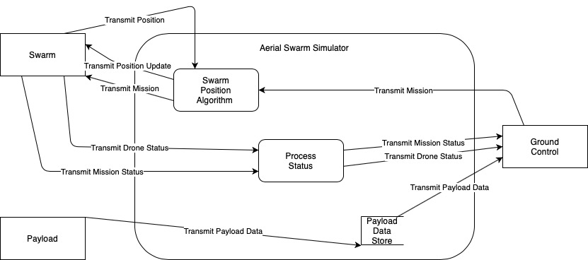
Sub-System Design
Level 0 Data Flow Diagram
Level 1 DFD

Slide 6
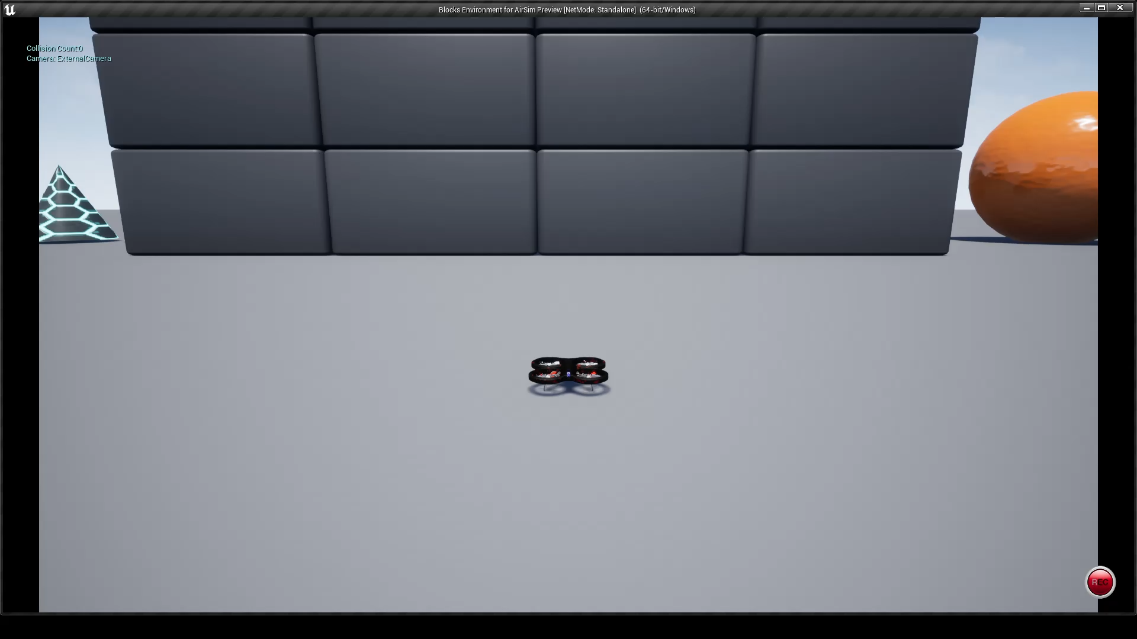
Environment Demo

Slide 7
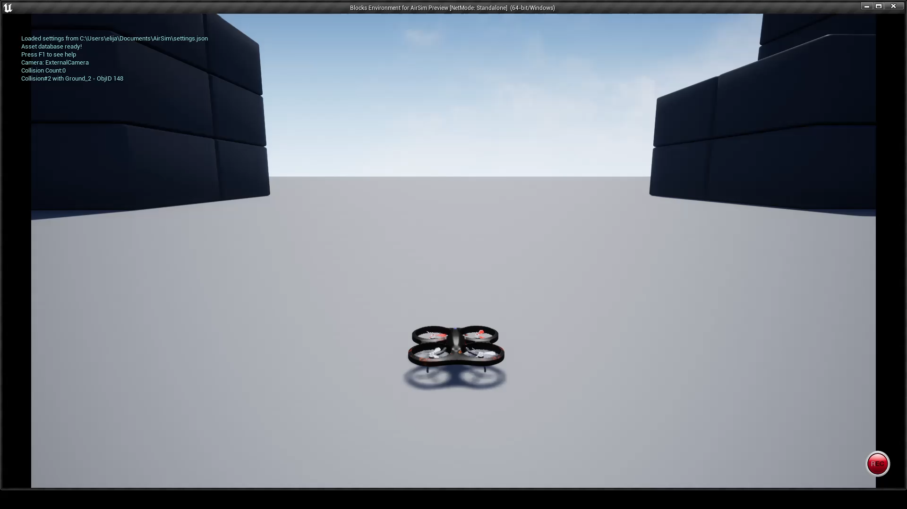
Single Drone Spawn Demo

Slide 8
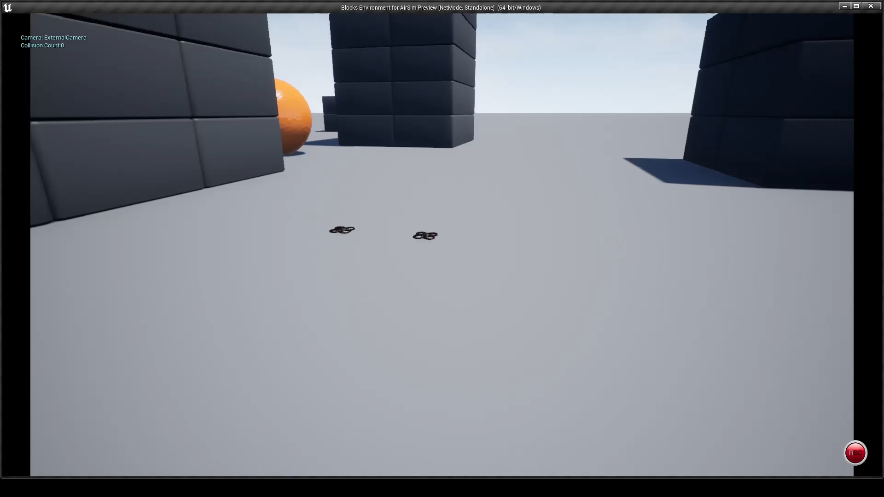
Dual Drone Spawn Demo

Slide 9
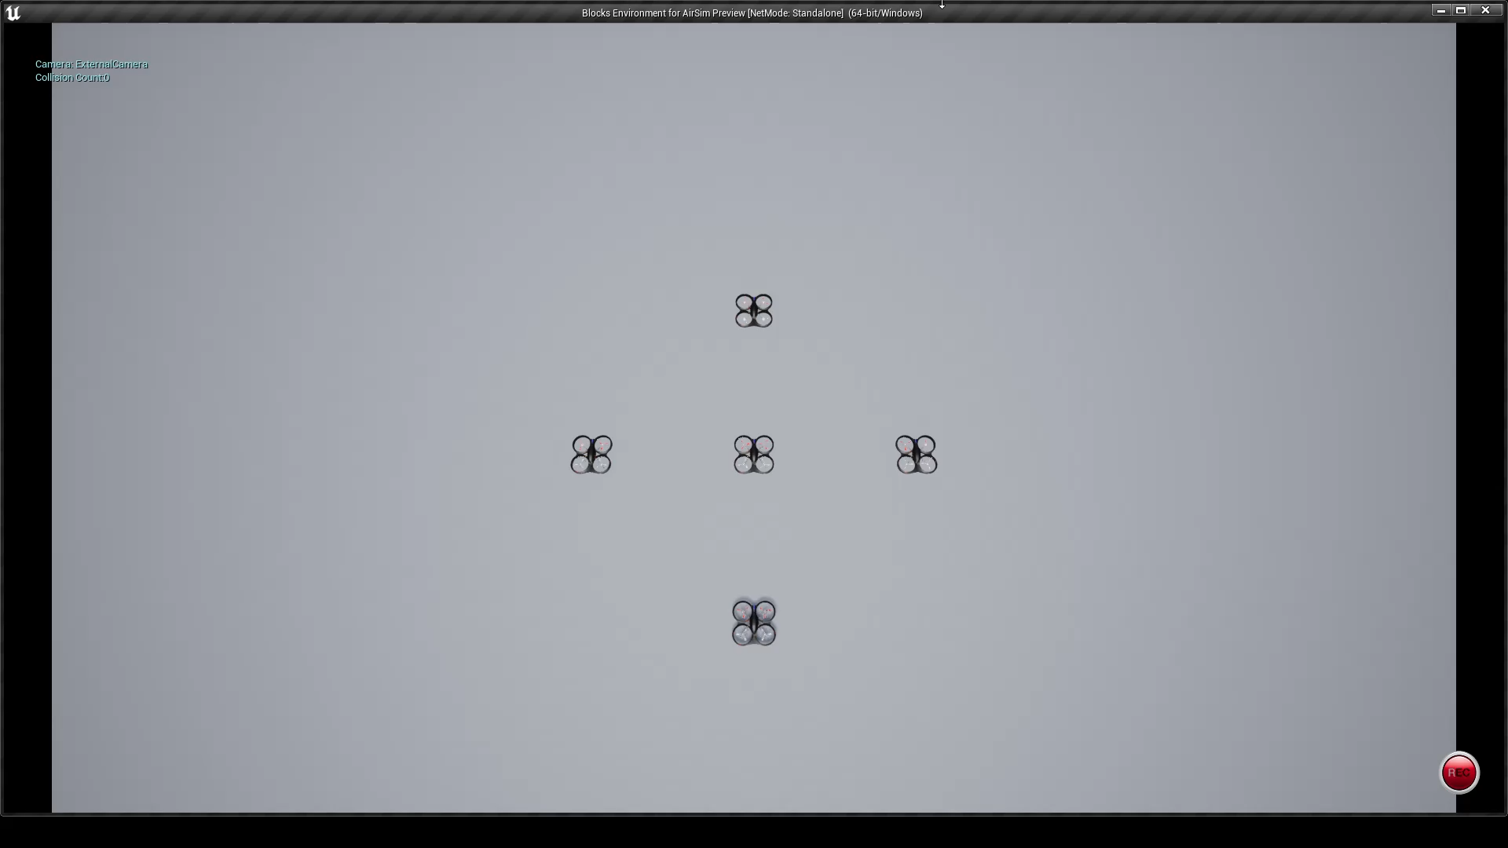
Drone Swarm Spawn Demo

Slide 10
Lessons Learned
Improve time management
Increase collaboration
In person meetings outside of class time

Slide 11
Project Timeline
Sprint 1
Model multiple UAV
Develop motion behavior for UAV
Create “pong” style game with two UAV communication
SRS V1.0
SDD V.10

Slide 12
Project Timeline
Sprint 2
Test Plan V1.0
Create unified swarm
Develop motion of swarm within three-dimensions
Model ground station
Allow ground station to issue mission tasks
Swarm continues mission at all cost.

Slide 13
Project Timeline
Sprint 3
Model 3D geometric object
Use swarm to measure geometric object
Model 3D non-standard object
Use swarm to measure non-standard object
Final Demonstration

Slide 14
Questions?
Thank You!

